Slide 1
Having the Freedom to Challenge: decolonising the curriculum through academic skills
Dr Rhian Wyn-Williams
The Academic Achievement Team, LJMU

Slide 2
Early thoughts
Library role appeared to be decolonising reading lists.
A centralised teaching team offered potential: free from specific content and disciplinary canons; engage with issues, themes and voices otherwise not encountering.
Stimulated more critical thought about who we are and what we do.

Slide 3
‘Academic skills’ and decolonisation
Do learning developers uphold the status quo or can we participate in interrogating and challenging the colonised nature of learning in HE?
‘Study skills’ provision: a deficit approach that reinforces colonised homogeneity and focuses on acculturation (Robinson-Pant and Street, 2012; Bhopal, 2018).
Academic literacies and learning development: a more emancipatory approach. Elucidate academic practices (Lea and Street, 2006; Robinson-Pant and Street, 2012; Burke, 2015).
Therefore, naturally aligns itself to exposing the power and structural inequalities embedded in those practices.

Slide 4
Developing a decolonised academic skills curriculum
To challenge and avoid tokenism. Recognise it is not the same as EDI (Burke, 2015; Tate and Baggley, 2017).
Race, gender, sexuality, class (Ahmed, 2009; Burton, 2015; Danvers, 2018).
Balance being explicit and inadvertently creating barriers.
Suggested decolonised lesson plans and resources, and consciously decolonised practices. Central teaching programme from Sept. 2019.
Faculty Academic Achievement Canvas course webinar programme from Jan. 2021: new opportunities to engage and lessen the learning burden.

Slide 5
Include non-Western citations and gender-neutral name and pronouns in example writing.
Jamie is writing about studying at university. In pairs, discuss how they could develop their critical writing.
Hennessy (2010) believes that first year university essays should be based on subject text-books and lecture notes. According to Choudrey (2015), academic essays should be well researched. This research should be done from books listed in the module handbook and using the online resources in the library. Beko (2013) says that assignments are written using information collected from the library, especially peer-reviewed articles. Johnson (2012) argues that students should use library resources and some academic websites.

Slide 6
Developing an argument (APSS)
Position themselves before developing a supported argument based on discussion and sources. Introduce them specifically to the Rhodes Must Fall campaign to relate to HE.

Slide 7
Summarising (Health)
Evaluate two examples to identify the key features of a summary
Introduced to summarising techniques
Apply techniques using an extract from Dean, Victor and Guidy-Grimes (2016), 'Inhospitable Healthcare Spaces: Why Diversity Training on LGBTQIA Issues Is Not Enough’, Journal of Bioethical Inquiry.
Given this example to analyse and self-assess:
'Although hospital staff receive diversity training, many LGBTQIA patients feel discriminated against due to subconscious microagressions that tell them heterosexuality is considered the norm (Dean, Victor and Guidy-Grimes, 2016).’
Enabled discussion about lived experiences and relate to HE systems.

Slide 8
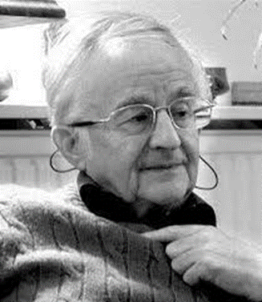
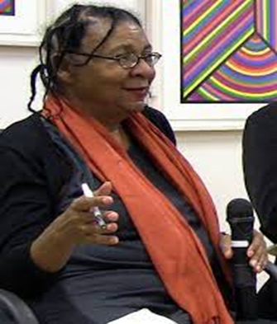
Essay planning: 'What is the role of HE?’ Mimic the process: Brainstorm Read - compare/contrast/ evaluate Identify themes Structure into a plan Consider why Rustin and hooks may have these views and relate to themselves.
Mike Rustin We have hard evidence to show that students are clear about why they want to go to university – it is about having a successful career.
bell hooks
When people frequently ask me, 'What enabled you to come from this working-class, segregated home … into being one of our nation's well-known intellectuals?' My answer is, 'It's there in that space where I learned to be a reader and a critical thinker.’

Slide 9
Positive initial responses
BAME Students Network in response to Stop and Search material: ‘This is brilliant. This is what happens – it’s our experience, so why hide it?’
A student at the end of a class on critical writing: ‘I’ve never thought about it [‘British Values’] like that before….but why haven't I?’
Wanted to more formally hear the student voice: avoid a new form of colonisation.

Slide 10
Curriculum Enhancement Project, June 2021
Analysed and evaluated a range of resources - some ‘decolonised’ and some not but following EDI principles.
How effective is our approach to decolonisation?
How successfully are we achieving our aims of decolonisation?
Interns evaluated and then conducted two focus groups with an exit survey.
10 voluntary participants, 2 males and 8 females with ages ranging from 20-24. 2 participants were from the BAME community, and 1 participant was an EAL student.

Slide 11
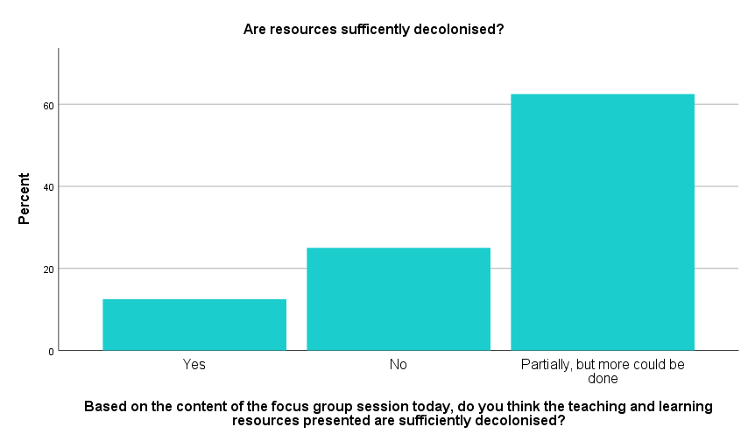
Findings and conclusions
“Not only a good thing but a necessary concept.”
A “safe space to start a discussion” and an “equitable learning environment.”
Welcome the challenge and opportunity to express their lived experiences.
Assumptions of those who 'fit' the white, middle-class, male 'norm’ challenged.
But we can do more – keep reviewing, reflecting and developing all our resources.

Slide 12
Where we are now
More confident that this is a positive approach.
We can challenge rather than reinforce the colonised nature of HE learning.
Online self-study resources: finding ways of bringing decolonised practices into these beyond signalling through content. Possible line for future research.
But still finding our way.

